Slide 1

Lecture (1)
Lecturer : Dr. Amira Gamal Mohamed

Slide 2
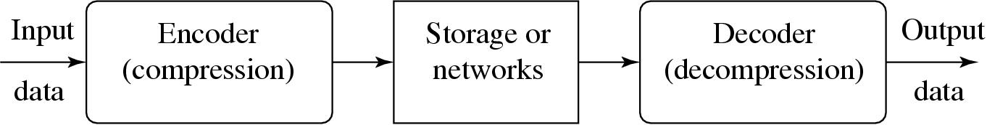
Introduction
Compression: the process of coding that will effectively reduce the total number of bits needed to represent certain information.
Why do we need Data Compression?
Compressed data take up less storage space.
Compressed data can be transmitted more quickly.

Slide 3
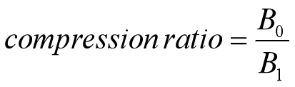
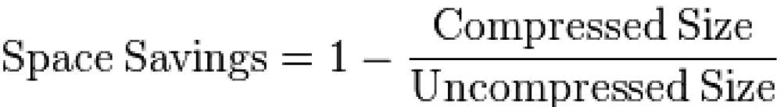
Compression ratio: is defined as the ratio between the uncompressed size and compressed size.
B₀ – number of bits before compression
B₁ – number of bits after compression
Example: a representation that compresses a 10 MB file to 2MB has a compression ratio of 10/2 = 5, often notated as an exploit ratio , 5:1
Saving Percentage: is defined as the reduction in size relative to the uncompressed size.
Example: a representation that compresses a 10 MB file to 2 MB would yield a space saving of 1-(2/10) = 0.8 often notated as a percentage, 80 %

Slide 4
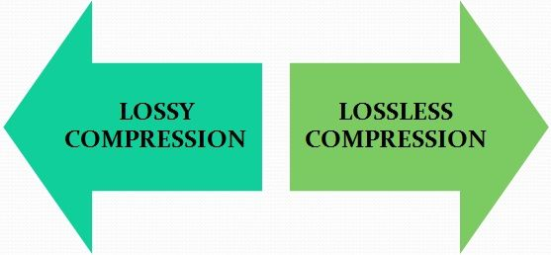
Types of Data Compression
lossy compression, the data in a file is removed and not restored to its original form after decompression
data is permanently removed, which is why this method is also known as irreversible compression.
Lossless compression restores and rebuilds file data in its original form after the file is decompressed.
The file can be decompressed to its original quality without any loss of data. This compression method is also known as reversible compression.

Slide 5
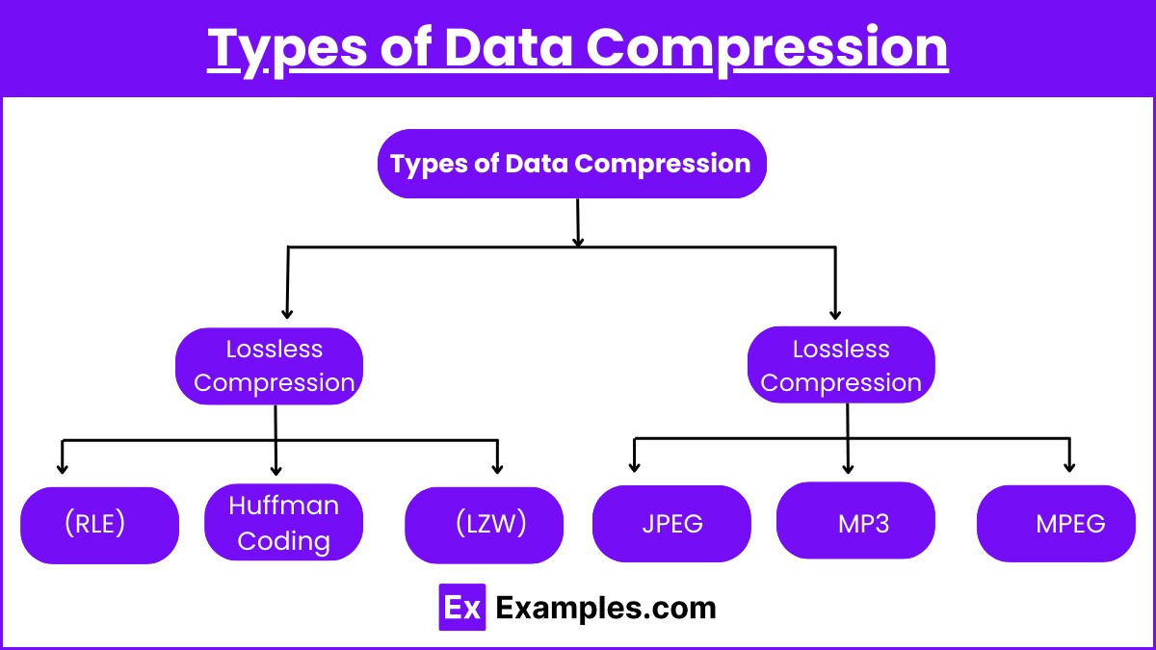

Slide 6
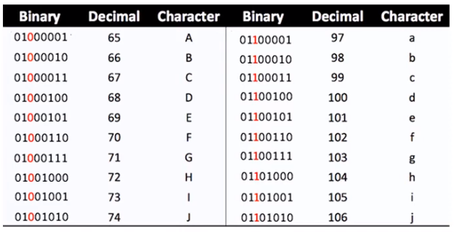
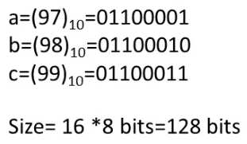
Lossless Compression: Run Length Code (RLC)

Slide 7
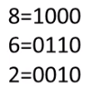



Run Length Code (RLC)
Number of Repetition Symbols
Number of Bits
120 Bits (original)
36 Bits (Compressed)

Slide 8
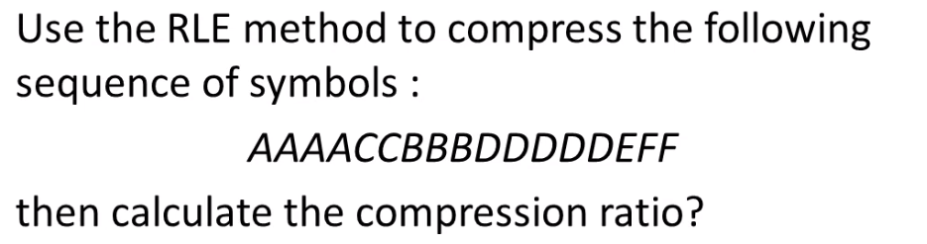
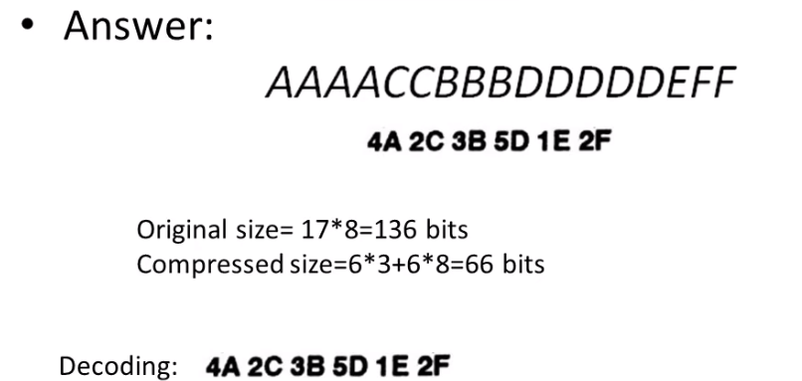
Example:

Slide 9
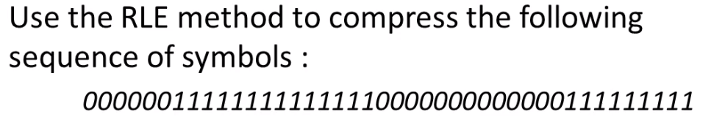
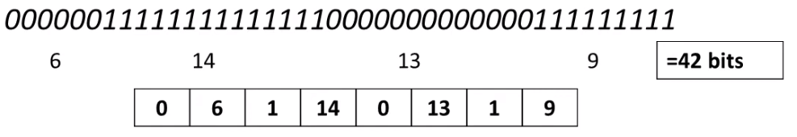
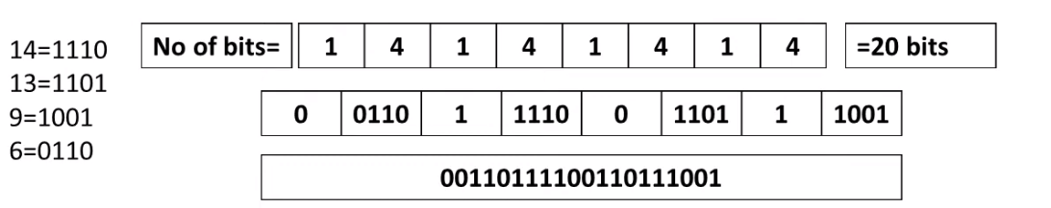
Example:
Answer:

Slide 10
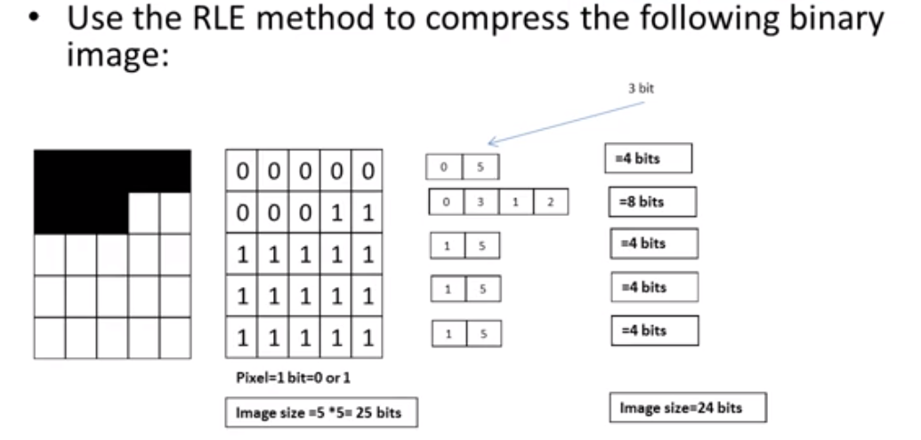
Example:

Slide 11

Lossless Compression: Huffman Coding
What is Huffman Coding?
Huffman coding is a greedy algorithm frequently used for lossless data compression. The basic principle of Huffman coding is to compress and encode the text or the data depending on the frequency of the characters in the text.
Huffman Coding Example
Let us understand how Huffman coding works with the example below: Consider the following input text:
Step 1: Looking at the text, the frequencies of the characters will be as shown in the below image.

Slide 12

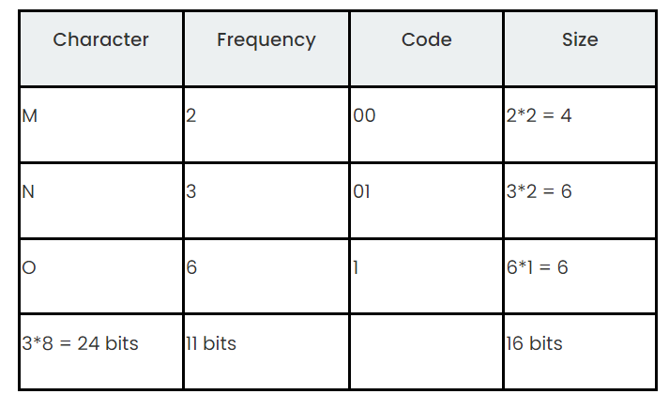
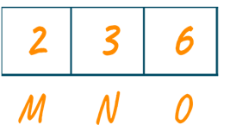
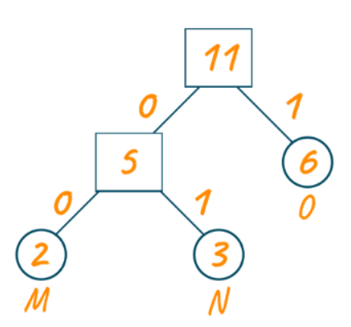
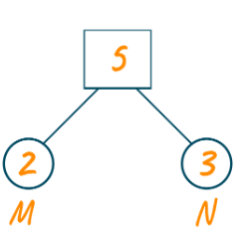
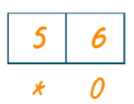
Step 2: we will sort the frequencies string of the characters in increasing order.
Step 3: we will create the Huffman tree using this priority queue.

Slide 13

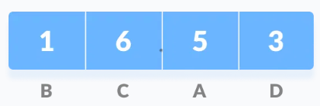
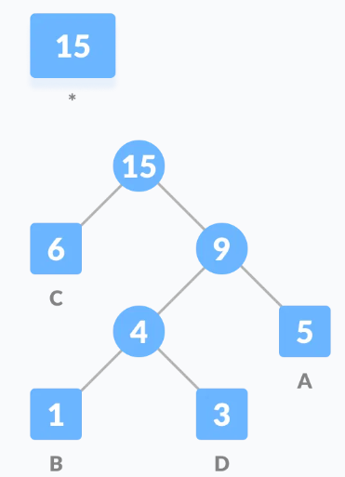
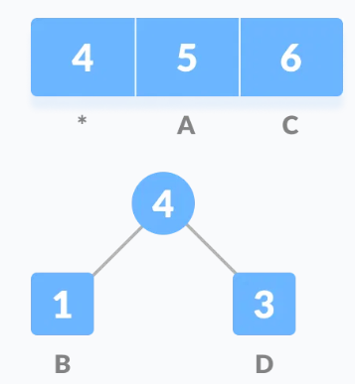
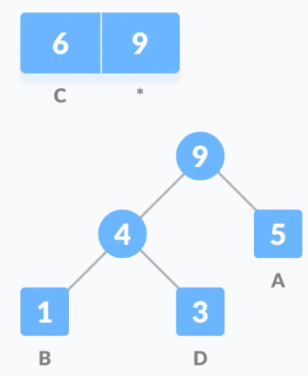
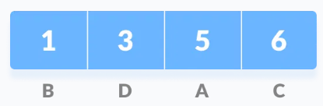
Example:
Step 1
Step 3
Step 4
Step 5
Step 2

Slide 14
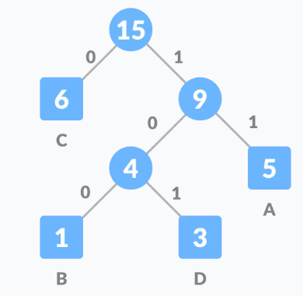
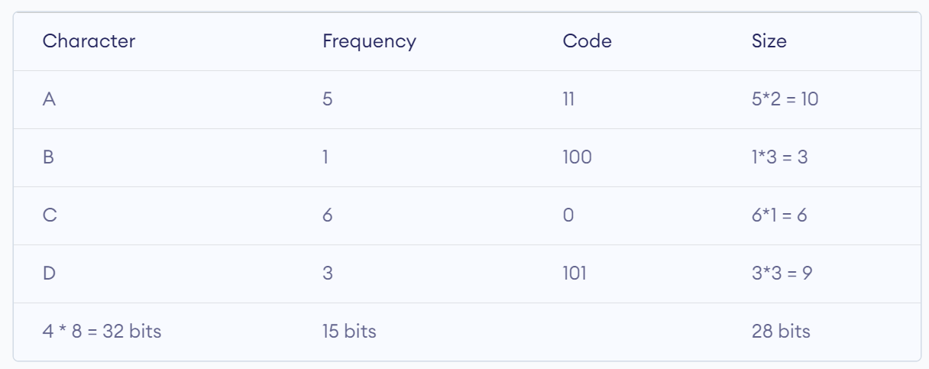

Slide 15
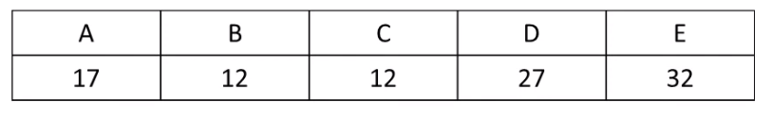
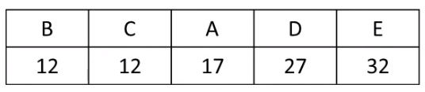
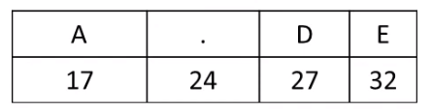
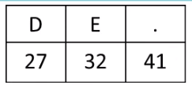
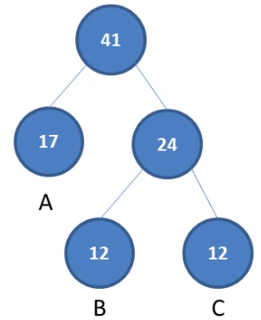
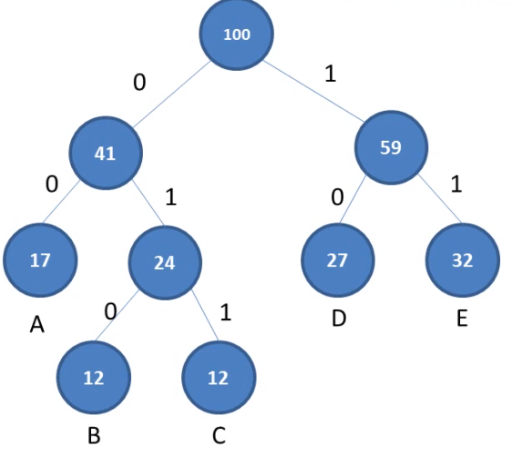
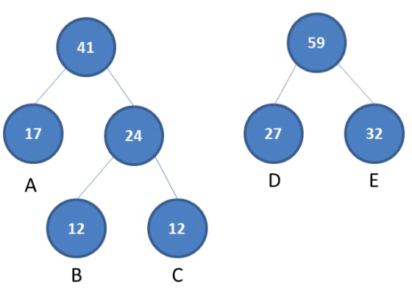
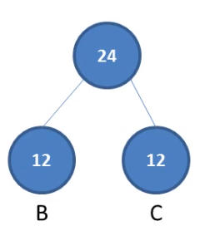
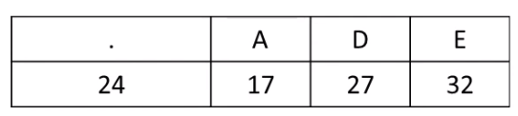
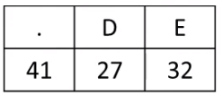
Example:
Step 1
Step 3
Step 4
Step 2

Slide 16
